Slide 1


GIT - Pull & Push
Presented By: Rakhi Pareek
Notes:
Note: First “Right Click” on the Gradient background, go to “Order” option and “Send it to Back”, then insert your picture into “Image Placeholder”, “Right Click” on the picture and again go to “Order” option and “Send it to Back” to get the “Gradient” effect.

Slide 2

Our Agenda
GIT Commands - Push & Pull
01
Push & Pull Introduction
02
Creating of repository on Github
03
Commiting the changes
04
Push command Execution
05
Pull command execution

Slide 3
Pull & Push Introduction
Git - push & Pull
Git Introdction
Push Introduction
Pull Introduction
Git is an open-source distributed version control system. It is designed to handle minor to major projects with high speed and efficiency. It is developed to co-ordinate the work among the developers. The version control allows us to track and work together with our team members at the same workspace.
The push term refers to upload local repository content to a remote repository. Pushing is an act of transfer commits from your local repository to a remote repository. Pushing is capable of overwriting changes; caution should be taken when pushing.
The term pull is used to receive data from GitHub. It fetches and merges changes from the remote server to your working directory. The git pull command is used to pull a repository.

Slide 4
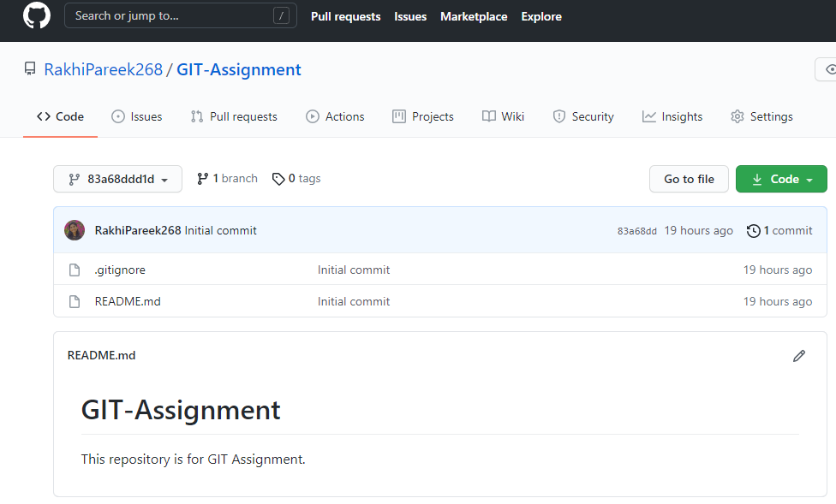
Creating Repository on Github
New repository on Github

Slide 5
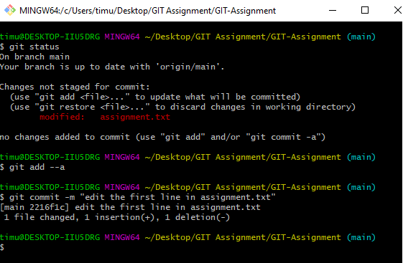
Commiting the changes
commiting the changes using git bash

Slide 6
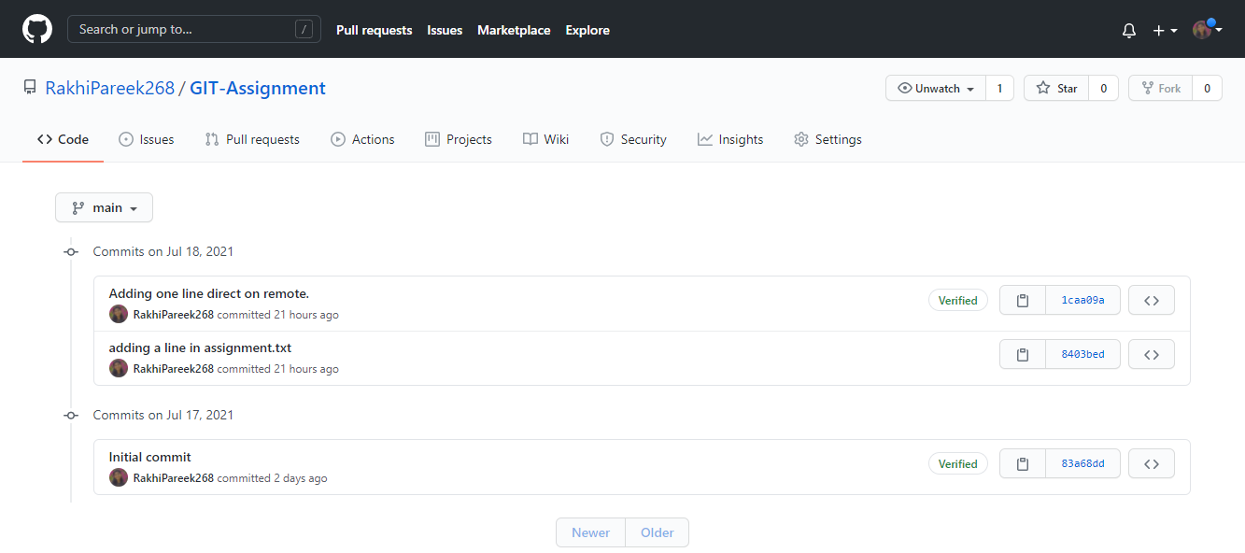
Commiting the changes
commits on Github repository

Slide 7
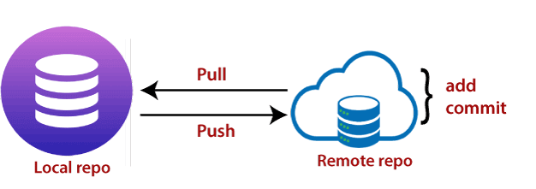
Workflow of Push & Pull
Execution of Push & Pull in git hub repository

Slide 8
Push
Execution of Push
The "git push" command is used to push into the repository. The push command can be considered as a tool to transfer commits between local and remote repositories. The basic syntax is given below:
$ git push <option> [<Remote URL><branch name><refspec>...]

Slide 9
Push
Execution of push
Git Push Tags :-
<repository>: The repository is the destination of a push operation. It can be either a URL or the name of a remote repository.
<refspec>: It specifies the destination ref to update source object.
--all: The word "all" stands for all branches. It pushes all branches.
--prune: It removes the remote branches that do not have a local counterpart. Means, if you have a remote branch say demo, if this branch does not exist locally, then it will be removed.

Slide 10
Push
Execution of push
Git Push Tags :-
--mirror: It is used to mirror the repository to the remote. Updated or Newly created local refs will be pushed to the remote end. It can be force updated on the remote end. The deleted refs will be removed from the remote end.
--dry-run: Dry run tests the commands. It does all this except originally update the repository.
--tags: It pushes all local tags.
--delete: It deletes the specified branch.

Slide 11
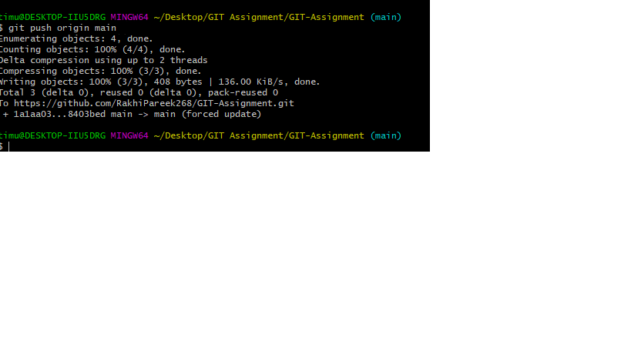
Push
Execution of push

Slide 12
Pull
Execution of pull
The git pull command is used to fetch and download content from a remote repository and immediately update the local repository to match that content. Merging remote upstream changes into your local repository is a common task in Git-based collaboration work flows. The git pull command is actually a combination of two other commands, git fetch followed by git merge. In the first stage of operation git pull will execute a git fetch scoped to the local branch that HEAD is pointed at. Once the content is downloaded, git pull will enter a merge workflow. A new merge commit will be-created and HEAD updated to point at the new commit.
Command for pull :- $ git pull <remote>

Slide 13
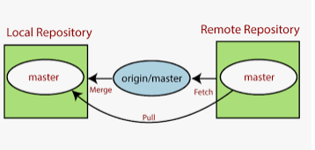
Workflow of Pull
Execution of pull

Slide 14
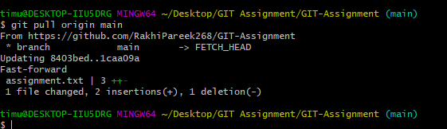
Pull
Execution of pull

Slide 15
Github Repository Link
Remote repository link
https://github.com/RakhiPareek268/GIT-Assignment/commits/main

Slide 16
Thank You !

